Slide 1
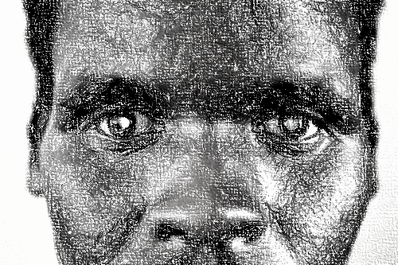
HOW TO FACE CHALLENGES
YPES OF CHALLENGET
S

Slide 2

TYPES OF CHALLENGES
Family challenges
Peer challenges
Friendship challenges
Poverty

Slide 3

HOW TO DEAL WITH FAMILY CHALLENGES
Everyone has a background that allows him/her to have a sense of belonging

Slide 4

BYE

